Slide 1



HUMANs at the center of mir:
Human-subjects Research Best Practices
Not too late to do the experiment!
Notes:
Image credit:

Slide 2

HUMANs at the center of mir:
Not too late to do the experiment!
Human-subjects Research Best Practices
Notes:
Image credit: newyorker.com (https://www.newyorker.com/magazine/2023/04/03/david-sulzer-profile-neuroscience-music) “The Wild World of Music”
Artist Surname, First Initial. Second Initial. (Year the artwork was created/picture was taken). Title of the artwork/picture [Format]. URL (address of website)

Slide 3
Tutorial outline
INTRODUCTION
Overview
Use cases in MIR
Experimental Design
Validity and Reliability
Sampling
Measurement & Randomness
Statistical Evaluation
Psychometrics
Reporting in APA
Ethics and Approval
New Publication standards
2:00 - 2:15
2:15 - 3:00
PART 1
PART 2a
3:00 - 3:30
3:30 – 4:00
COFFEE BREAK
PART 2a
4:00 – 4:15
(continued)
PART 2b
4:15 - 4:45
PART 3
4:45 - 5:30

Slide 4





WHO ARE WE?
Joshua Albrecht
University of Iowa
Claire Arthur
Georgia Institute of Technology
David Sears
Texas Tech University
Nat Condit-Schultz
Georgia Institute of Technology
J. Ashley Burgoyne
University of Amsterdam
Notes:
All of us are university professors in schools of music (or arts or humanities). We collectively share decades worth of expertise in human- subjects research, experimental methods, music data analysis, and statistical modeling.

Slide 5
introduction
In one form or another, most MIR research depends on the judgment of humans.
Humans provide our ground-truth data, evaluate our results, and consume our tools, and models, and music. Will users like it? Will customers buy it? Does it sound good? These are all critical questions for MIR researchers which can only be answered by asking people.
Notes:
Our tutorial today is framed by the following introductory statement…

Slide 6

USE CASES in MIR
Notes:
Source: freepik
So let’s jump in to our two use cases in MIR that we will use to (mostly) frame our tutorial today…

Slide 7
introduction
SCENARIO 1: Source Separation
You have made a source separation model. You need to do subjective testing with human participants to validate that the separation isolates tracks better than other models, while minimizing artifacts and preserving audio fidelity. (Ultimately, perceptual problems).

Slide 8
introduction
SCENARIO 2: Music Emotion Recognition
You have designed a model for automatically detecting musical emotion from audio (MER), a highly subjective (and human-dependent) task. You plan to use human participants both for subjective evaluation and, possibly, human feedback to refine model.

Slide 9
WHAT YOU WILL LEARN IN THIS TUTORIAL
Common pitfalls and considerations in designing User Studies and Human Subjects research
Critical examination of experimental design to maximize results potential
Intro/overview of statistical techniques and evaluation
Dealing with human subjectivity (ignoring it doesn’t make it go away!)
Standards for methods, reporting and publishing
Notes:
Subjectivity & randomness
Ignoring subjectivity doesn’t make it go away

Slide 10
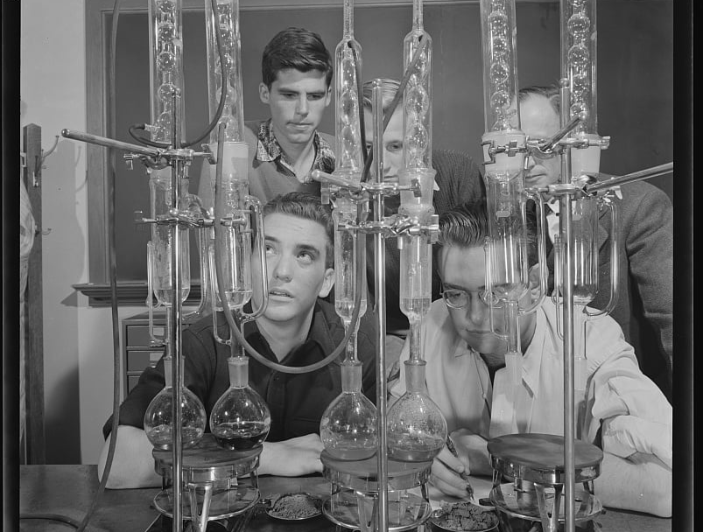
PART 1: EXPERIMENTAL DESIGN
Notes:
Image: https://cdn4.picryl.com/photo/1942/01/01/science-and-research-mineral-prospecting-chemical-prospecting-for-oil-becomes-1024.jpg (creative commons)

Slide 11
Part 1 Outline
Experimental Design
Manipulation and causation
Variables & Groups
Controls
Measurement
Survey Design
Stimuli Design
Validity and Reliability
Demand characteristics
Sampling
Sampling music
Sampling humans
Notes:
Ask Josh & Ashley if they want to change anything here?

Slide 12
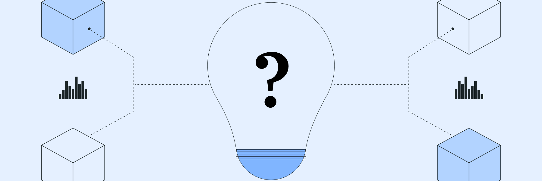

Designing your experiment
What is the goal?
Capturing data that will best allow for the evaluation of your hypothesis.
Ensuring the hypothesis has a chance to fail.
Notes:
Images: https://www.flickr.com/photos/32091032@N06/3255180761,

Slide 13
Designing your experiment
Capturing data that will best allow for the evaluation of your hypothesis:
Types of questions
Type of task (rate; rank; choose; etc.)
Clarity of instructions
Appropriate stimuli (selection, length)
Order effects
Appropriate controls and conditions
Participant pool & generalizability
Understanding and avoiding bias
Notes:
This means considering many factors, such as…

Slide 14
Variables
Dependent Variable: The thing you are measuring. A.k.a. the response variable; the outcome variable.
Independent Variable: A variable that is manipulated or changed in the experiment/study to observe its effect on a dependent variable. A.k.a. the predictor variable; the condition.
Notes:
One of the most obvious but important things in experimental design are variables. There are two primary categories of variables… What can be a bit confusing or tricky in the context of MIR is that commonly our independent variable---or the thing being manipulated---is the model (in other words, you have YOUR model, and then one or more alternative models to compare against). In this case, assuming all other things being equal in the process; the model is actually the independent variable. We will go through a few examples of “conditions” or IV in a moment…

Slide 15
Manipulation & Causation
“No causation without manipulation”
Subjective evaluation frequently in the form of surveys, which are often correlational
Internal Validity
Manipulating one variable (independent variable) to examine impact on a response variable (dependent variable) in order to infer causality (and not just correlation).
Notes:
Now, in true experiments we need manipulation to be able to talk about causation. (This is a helpful slogan that some of us here today learned as graduate students)...
Now sometimes, subjedtive evaluations are surveys that are purely correlational in which case we cannot talk about causation. But assuming that we have an independent variable that is correctly being manipulated we CAN talk about causation. However...
This pretext of “all other things being equal” with regard to the manipulation of an independent variable is quite important…
If we observe that changes in phenomena A correlate with changes in phenomena B, we might postulate that changes in A cause changes in B. However, justifying inductive claims about causation is tricky, a problem known as internal validity.
Internal validity refers to how well the results are genuinely attributable to the factors being tested (Josh will talk more about validity later; but I wanted to point out the connection of manipulation to internal validity).

Slide 16
Examples:
SCENARIO 1:
SOURCE SEPARATION EVALUATION
Stimuli created by (or grouped by) condition (i.e., different models)
Are there changes in the stimuli that could arise from causes other than the main condition (or IV) of interest?
Notes:
What we of course want to do is evaluate how people rate perceived quality of audio samples/stimuli that have been source separated…. So we
Using the same music separated by different models?
Using distinct, pre-existing separated music provided by the original model authors?
(We’ll come back to controls in a moment…)

Slide 17
Examples:
SCENARIO 2:
EMOTION RECOGNITION EVALUATION
People rate perceived emotion of samples/stimuli, and:
Compare against ground truth labels from your model?
Compare against ground truth labels from multiple models?
Notes:
Things may look a little different in an MER task where we may want to have humans “validate” the perceived emotion from a piece of music; and we’d ideally want to see that our model is performing in alignment with the human choices….
Now we will talk about types of tasks in a few minutes, but unlike source separation where we might have a rating or a ranking task; the dependent variable from an MER experiment may be a categorical one (i.e., select the most appropriate emotion label)
If the DV are the emotion judgements; and the IV is the model, then how might we evaluate that?
MER IS a prime example of a highly subjective task, since what sounds fearful to one person might sound angry to another person. In these kinds of highly subjective tasks we typically are looking for consensus. (And Nat will talk in Part 2 about how to analyze this type of data).
#The stimuli selection as well would be incredibly important in an experiment on MER in the first place (there are an awful lot of variables that influence the outcome(s))
And we will come back to that point when we talk about stimuli and randomness.

Slide 18
Conditions, Controls, Covariates
To be confident claiming X causes Y, we have to be cautious that there are not other explanations.
Conditions: Different setups or variations in an experiment used to test effects on the outcome (i.e., IV).
Controls: Elements held constant to prevent them from influencing the outcome, ensuring that only the variable of interest affects the results.
Covariates:Additional variables that may impact the outcome and are measured to account for their influence in the analysis.
Notes:
“other explanations” = COFOUNDS
So as I mentioned earlier, when we are asking: “Are there changes in the stimuli that could arise from causes other than the main condition (or IV) of interest?” if the answer is “yes” or “maybe?...” then we won’t be able to be confident in any claims of causality. If there are potentially other changes that could account for our effects, then those changes must be identified and held constant, or identified and measured…

Slide 19
Conditions, Controls, Covariates
To be confident claiming X causes Y, we have to be cautious that there are not other explanations.
Conditions: Different setups or variations in an experiment used to test effects on the outcome (i.e., IV).
Controls: Elements held constant to prevent them from influencing the outcome, ensuring that only the variable of interest affects the results.
Covariates:Additional variables that may impact the outcome and are measured to account for their influence in the analysis.

Slide 20
Conditions, Controls, Covariates
To be confident claiming X causes Y, we have to be cautious that there are not other explanations.
Conditions: Different setups or variations in an experiment used to test effects on the outcome (i.e., IV).
Controls: Elements held constant to prevent them from influencing the outcome, ensuring that only the variable of interest affects the results.
Covariates:Additional variables that may impact the outcome and are measured to account for their influence in the analysis.
A.K.A. “Levels” of the Independent Variable(s)
E.g., Model A vs. Model B vs. Model C
Notes:
Between / Within subject design (rarely comes up in MIR) .
Controls: music therapy example (Nat)
- Lab settings; group settings
**ask Josh: talking about within/between in the context of demand characteristics?

Slide 21
Conditions, Controls, Covariates
To be confident claiming X causes Y, we have to be cautious that there are not other explanations.
Conditions: Different setups or variations in an experiment used to test effects on the outcome.
Controls: Elements held constant to prevent them from influencing the outcome, ensuring that only the variable of interest affects the results.
Covariates:Additional variables that may impact the outcome and are measured to account for their influence in the analysis.
A.K.A. “Levels” of the Independent Variable(s)
(E.g., Medicine vs. Placebo)
(Fast vs. Slow Tempo)
Notes:
Other examples NOT in MIR:
Medicine vs. Placebo;
Tempo of music on mood

Slide 22
Conditions, Controls, Covariates
To be confident claiming X causes Y, we have to be cautious that there are not other explanations.
Conditions: Different setups or variations in an experiment used to test effects on the outcome.
Controls: Elements held constant to prevent them from influencing the outcome, ensuring that only the variable of interest affects the results.
Covariates:Additional variables that may impact the outcome and are measured to account for their influence in the analysis.
E.g., Source Separation:
Number of instruments
Type of instruments/voice
Presence of effects
Source file!
E.g., MER
Genre
Loudness
Presence of lyrics
Notes:
Controls are held constant across the independent variable (or else included as a “dummy” condition or, if we actually care about that factor’s influence we may use it as another independent variable or ‘condition’).

Slide 23
Conditions, Controls, Covariates
To be confident claiming X causes Y, we have to be cautious that there are not other explanations.
Conditions: Different setups or variations in an experiment used to test effects on the outcome.
Controls: Elements held constant to prevent them from influencing the outcome, ensuring that only the variable of interest affects the results.
Covariates:Additional variables that may impact the outcome and are measured to account for their influence in the analysis.
E.g., Source Separation:
Musical expertise
Listening environment
Song familiarity
E.g., MER
Person’s current mood
Musical preferences
Time of day
Notes:
Covariate examples. Source Separation---
Musical Expertise: Listeners with formal musical training may perceive separation quality differently compared to non-musicians.
Listening Environment: The type of headphones, speakers, or room acoustics can affect how well participants perceive separated sources.
Familiarity: If participants are familiar with the original song, they might have preconceived expectations about what the separated sources should sound like.
Music Emotion---
Mood or Energy State: The current emotional and arousal state of the listener can affect how they interpret the emotion of a music piece.
Musical Preferences: Personal taste or familiarity with certain genres might influence participants' emotional responses. A fan of heavy metal may perceive a metal song as energizing, while someone unfamiliar might find it angry or stressful.
Time of Day: The time when participants listen to the music (e.g., early morning vs. late at night) could affect their emotional responses due to natural fluctuations in mood and energy levels
By measuring and recording the variation in these variables, we can account for them in the analysis. Specifically, they can be included in a statistical model to better isolate the effect of our main independent variable(s). [Nat will cover more on that later on in Part 2]

Slide 24
RANDOMIZATION
Stimuli controls
When not every confounding variable can possibly be controlled…
Order effects
Hearing a sad song after an uplifting song?
Getting better at a task over time
Notes:
Finally, not EVERYTHING can be conrtolled in an experiment. This is where randomization helps to alleviate any potential accidental confounds.

Slide 25
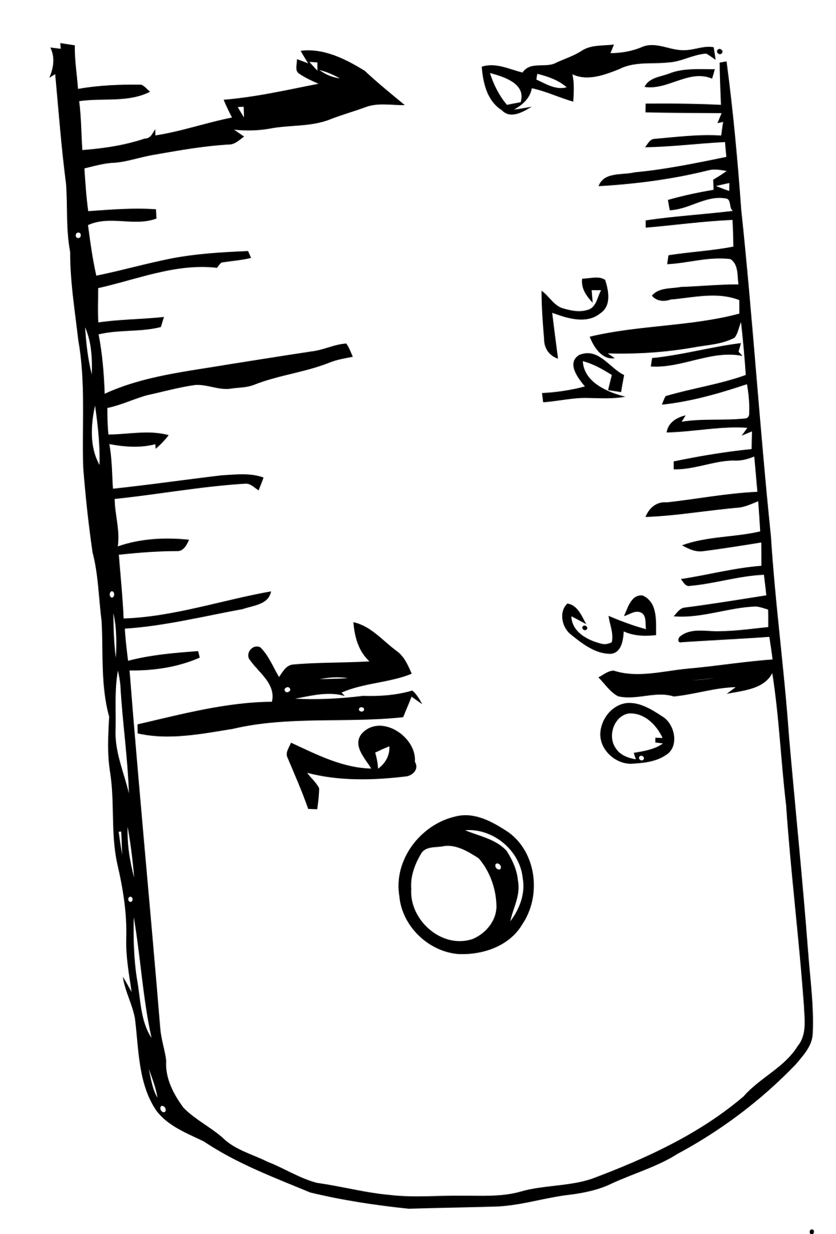
What Are we Measuring?
Clarity of Instructions
Type of task / question
Scale and unit of measure
Risks of bias
Notes:
Finally, this may seem obvious, but as someone who has conducted many experiment (and who is a frequent reviewer of journal articles) I can assure you that it is fairly common that what may seem obvious to an experimenter that they are measuring may not be obvious to a participant! (Or a reviewer!) There are several factors to consider when asking onself whether you are truly measuring what you think you are….

Slide 26
What Are we Measuring?
Types of data collection:
Physiological measures:
GSR
Heartrate
Error:
Rate
Confusion
Task time:
Reaction
Explore
Narrative analysis:
Gesture / behavior
Semantic analysis:
Themes
Associations
Implicit
Quantitative
Qualitative
Survey:
Rate
Rank
Choose 1
Error:
Knowledge assessment
Skill tests
Survey:
Describe
Explain
Compare
Observation
& Field work
Measure
Interview
Explicit

Slide 27
What Are we Measuring?
SOURCE SEPARATION
MUSIC EMOTION RECOGNITION
Notes:
Let’s go through a few examples of ways that we might possibly measure our dependent variables given our two example tasks…

Slide 28
What Are we Measuring?
SOURCE SEPARATION
MUSIC EMOTION RECOGNITION

Slide 29
What Are we Measuring?
SOURCE SEPARATION
MUSIC EMOTION RECOGNITION
Types of Questions: | Pros | Cons
Choose the file that… | Faster than rating; rank-order data | Lots of comparing = slow
Rate each file on a 0-100 scale for … | data for each file; (likely) normally-distributed data, specific | Less intuitive; more variation in responses; takes longer
Compare two files for … | Easy, fast, intuitive (more reliable) | Inefficient: Lots of pairs in order to be exhaustive; more difficult to analyze
Notes:
Inherent trade-off between the simplicity and ease of the experiments and questions (for the participants), and the amount of detailed data you collect and how easy it will be to analyze as well.
Other things to consider would be how many participants you can expect to have. If you will have fewer participants then minimizing variation will be helpful (i.e., rating each file perhaps not best option in that case).

Slide 30
What Are we Measuring?
SOURCE SEPARATION
MUSIC EMOTION RECOGNITION
Clarity of Instructions:
What is meant by “overall quality”?
success of isolation?
fidelity of the audio?
timbral purity/accuracy?
smoothness and continuity of the isolated track?

Slide 31
What Are we Measuring?
SOURCE SEPARATION
MUSIC EMOTION RECOGNITION
Clarity of Instructions:
What is meant by “overall quality”?
success of isolation?
fidelity of the audio?
timbral purity/accuracy?
smoothness and continuity of the isolated track?

Slide 32
What Are we Measuring?
SOURCE SEPARATION
MUSIC EMOTION RECOGNITION
Clarity of Instructions:
What is meant by “overall quality”?
success of isolation?
fidelity of the audio?
timbral purity/accuracy?
smoothness and continuity of the isolated track?
Types of Questions: | Pros | Cons
Rate each file on a 0 - 7 scale for [various discrete emotions]… | data for each emotion; (likely) normal-ish data; detailed | Challenging; more variation in responses; takes longer
Choose one/all the emotion words that apply [select task] | Faster and easier than other options; binary | Experimenter-selected vocab (bias?)
Name the emotion term [free response] | Individualized (inclusive) | Messy to analyze
Rate valence & arousal in 2D space | Simplicity, common benchmark | Less intuitive; more variation; potentially limiting

Slide 33
What Are we Measuring?
MUSIC EMOTION RECOGNITION
Clarity of Instructions:
What is meant by “emotion”?
Felt versus perceived
Relation to mood
Categorical vs dimensional

Slide 34
What Are we Measuring?
Scale and unit of measure
Measurement Scales
Continuous vs. Discrete data
Unit of Measurement
Nominal: categories with no order (e.g., genres)
Ordinal: rank order (e.g., disagree, neutral, agree)
Interval: equal intervals but no zero (e.g., dates, IQ
Ratio: same as interval but meaningful zero (e.g., time taken)
Continuous: any unbounded (or bounded) value; highly precise (e.g., time, heart rate)
Discrete: distinct, separate values; often counts of items (e.g., key signatures, instrument labels, distributions)
The magnitude of the measure
Examples:
Decibels
BPM for heartrate
Milliseconds (ms) for reaction time.
Notes:
Nat covers this??

Slide 35
Factors influencing responses
Time of day
Mood of participant
Socioeconomic status/cultural background
Order effects
Maturation/fatigue effects
Question asked
Wording

Slide 36
Reliability
Reliability
The consistency of the measure
Observing the same value over time in similar circumstances
Notes:
Finally, not EVERYTHING can be conrtolled in an experiment. This is where randomization helps to alleviate any potential accidental confounds.

Slide 37
Reliability
Intrasubjective reliability
Consistent responses from the same participant
Test/retest reliability
Re-engaging participant after some time
Notes:
Finally, not EVERYTHING can be conrtolled in an experiment. This is where randomization helps to alleviate any potential accidental confounds.

Slide 38
Reliability
Intersubjective reliability
Consistent responses from the different participants under similar conditions
Dependent on effect size
Notes:
Finally, not EVERYTHING can be conrtolled in an experiment. This is where randomization helps to alleviate any potential accidental confounds.

Slide 39
Reliability
MER
Perceived emotion/affect more reliable than felt/induced emotion/affect
“Please listen to the entire excerpt and rate how much of the following categories you feel it expresses.”
Notes:
Finally, not EVERYTHING can be conrtolled in an experiment. This is where randomization helps to alleviate any potential accidental confounds.

Slide 40
Validity
Validity
The degree to which the test measures what it claims to measure
“Grade the Basic Audio Quality of the isolated part of each stimuli with respect to the reference mix.”
Notes:
Finally, not EVERYTHING can be conrtolled in an experiment. This is where randomization helps to alleviate any potential accidental confounds.

Slide 41
Validity
Internal Validity
When the measures of the sample are correct
The results of individual responses generalize to the sample studied
Notes:
Finally, not EVERYTHING can be conrtolled in an experiment. This is where randomization helps to alleviate any potential accidental confounds.

Slide 42
Validity
External Validity
When the sample is truly representative of the population of interest
The results of your sample generalize to the broader population
Notes:
Finally, not EVERYTHING can be conrtolled in an experiment. This is where randomization helps to alleviate any potential accidental confounds.

Slide 43
Validity
External Validity Strategies
Compare your results to other studies
Conduct replications
Pre-registration
Use more than one competing (independent) operationalizations
Look for converging evidence
Ecological validity
Notes:
Finally, not EVERYTHING can be conrtolled in an experiment. This is where randomization helps to alleviate any potential accidental confounds.

Slide 44
Operationalization
Study how the timbres used in heavy metal music affect the perceptions of conveyed emotion
Heavy metal music
Timbre
Timbres used
Emotion
Conveyed emotion
Perceptions of conveyed emotion
Affects

Slide 45
Operationalization
Approximation or estimation of concept that can be operationally used
Perception of affect:
“Selections on a 7-point scale in response to a question about perceived affect”

Slide 46
Demand characteristics
Any aspect of the experiment that causes a change in a participant’s behavior
Participant perceptions of the experiment affecting their responses
e.g. placebo effect

Slide 47
Types of Demand characteristics
Cooperation bias
Contrarian bias
Acquiescence bias
Social desirability bias

Slide 48
Minimizing Demand characteristics
Blind procedure
Deception
Explicitly lying
Implicitly suggesting
Implicit measures
Debriefing

Slide 49
Sampling
Notes:
Must be representative. The Echo Nest was the predecessor to the Spotify API. CAL500 is a dataset of popular music from UCSD, designed for tagging research. What does this dataset represent?

Slide 50
Sampling
In academic environments (and even in industry), we rarely achieve ‘N = all’.
In MIR, we are almost always generalising from a model trained on a just a subset of musical fragments of interest.
Sampling is the way we choose that subset.
When human participants are involved, we not only need to sample music, but also our participants!

Slide 51
One Million Songs
Get the most ‘familiar’ artists according to The Echo Nest, then download as many songs as possible from each of them.
Get the 200 top terms from The Echo Nest, then using each term as a descriptor to find 100 artists, download as many of their songs as possible.
Get the songs and artists from the CAL500 dataset.
Get ‘extreme’ songs from The Echo Nest search parameters, e.g., songs with highest energy, lowest energy, tempo, song hotness, etc.
Take random walks along similar artist links, starting from the 100 most familiar artists.
Bertin-Mahieux et al. · 2011 · The Million Song Dataset
Notes:
Million Song Dataset. Does anybody know who The Echo Nest were? The predecessor to the Spotify API. CAL500 is a dataset of popular music from UCSD, designed for tagging research. What does this dataset represent?

Slide 52
One Thousand Songs
Select a random week between 4 August 1958 (the first week the Billboard Hot 100 was published) and 23 November 1991 (the last week the Hot 100 was compiled using surveys instead of Nielsen SoundScan).
Select a random rank between 1 and 100.
If the track on the Hot 100 for the week selected in Step 1 and the rank selected in Step 2 is commercially available, download it.
If not, try the tracks either one rank above and one rank below the desired rank, in random order.
If neither of these are available, try the tracks two ranks above and two ranks below the desired rank, in random order.
If none of these five tracks are available, download nothing.
Repeat Steps 1–3 until the desired number of tracks is reached.
Burgoyne, Wild, et al. · 2011 · An Expert Ground Truth Set
Notes:
McGill Billboard dataset. What does this dataset represent?

Slide 53
Post-stratification
Some songs in the McGill Billboard corpus are sampled more than once (e.g., songs that charted for multiple weeks).
An average listener would have been expected to have more exposure to these songs than those sampled only once.
If we want our models and predictions to be based on an average listener’s exposure, we need to weight these songs more heavily during training, testing, and validation.
Post-stratification is the term used for re-weighting model during or after training to match population characteristics.

Slide 54
Questions to Ask Yourself
What kinds of music and people are relevant for my research?
Are there subgroups (strata) of music or people that are relevant for my research?
Should each stratum have equal weight in my corpus or participant pool, or should some be weighted more heavily than others?
Within each stratum, do I have a random or near-random selection, or is there likely to be some sort of bias (e.g., toward more popular songs or highly-educated participants)? Is the bias a problem?

Slide 55
Missing Data Can Cause Bias
Data missing completely at random (MCAR) are missing for reasons that have nothing to do with parameters of interest (e.g., an unexpected Internet outage). These are OK…but rare.
Data missing at random (MAR) are missing for reasons that can be fully explained by observations (e.g., people who report that they do not like metal music are less likely to finish a study on metal music). These are often OK, but it can be difficult to prove that data are truly MAR.
Data missing not at random (MNAR) will lead to bias.

Slide 56
How Many Participants?
Power analysis uses formulas to ensure that traditional statistical tests will be unlikely to miss a true result (i.e., make a Type II error). The traditional threshold is a 20% chance that the test will reject a true result (80% power).
Traditional power analysis requires you to specify your expected effect size and population characteristics in advance. Online calculators like WebPower can help.
For example, when comparing the average ratings for two equally-sized groups, each of which have a standard deviation of σ across their ratings, traditional power analysis requires (5.6 σ / Δ)² participants.
If you are optimistic in estimating effect size, actual power can easily drop to just 10%!
A more modern approach is to use simulated data to assess how many participants are likely to be necessary.

Slide 57
How To Recruit
The best sampling strategies assume full access to your population of interest (e.g., choosing which users to A/B test).
More often, researchers have to rely on non-probabilistic convenience samples of whomever they can get.
Spamming the ISMIR list
Mechanical Turk or Prolific
Convenience samples may not generalise well!

Slide 58
Strata to Consider and Balance
Gender
Age
Education level
Cultural background
Linguistic background
Geographic location
Socio-economic status
Musical sophistication
Musical taste
Instruments played
Notes:
Some of these are very sensitive!

